Slide 1
Azure Stream Analytics
[ Instructor Name ]
[ Instructor E-mail ]

Slide 2

The Internet of Things (IoT)
Currently 20 billion devices connected to the Internet
By 2020, expect 50 billion or more
Health-monitoring devices
Thermostats, wind turbines, and solar farms
Cars, trucks, traffic lights, and drones
EVERYTHING will be connected
How do you process all that data?
How do you process it in real time?
Notes:
Extracting information from a database using queries (for example, SQL queries) is a well-understood science and is familiar to most researchers. Extracting information from high-volume, high-velocity data streams is an altogether different proposition. Imagine thousands of wind turbines firing telemetry data that includes gear-box oil temperatures (along with other information) at a centralized event hub. How would you write a query that, in real time, identifies all wind turbines whose average oil temperature over the last three minutes exceeds a certain threshold? The demand to process fast-moving data streams in this way is growing every day thanks to the proliferation of mobile phones and IoT devices.

Slide 3

Azure Stream Analytics
Highly scalable service for analyzing data in motion
Supports SQL-like query language for data analysis
Scales using Streaming Units (1 SU ~= 1 MB/sec)
Event Hubs
Event Hubs
Blob Storage
IoT Hubs
Azure SQL Database
Blob Storage
Other Output Sinks
Stream Analytics
Notes:
A good way to characterize Stream Analytics is to say that a database lets you determine how many red cars were sold last year. Stream Analytics lets you determine how many red cars are in the parking lot at any given time. A great example of why it's useful to perform temporal queries on streaming data can be found at http://bit.ly/1SE5g9X ("Connected Cows").

Slide 4
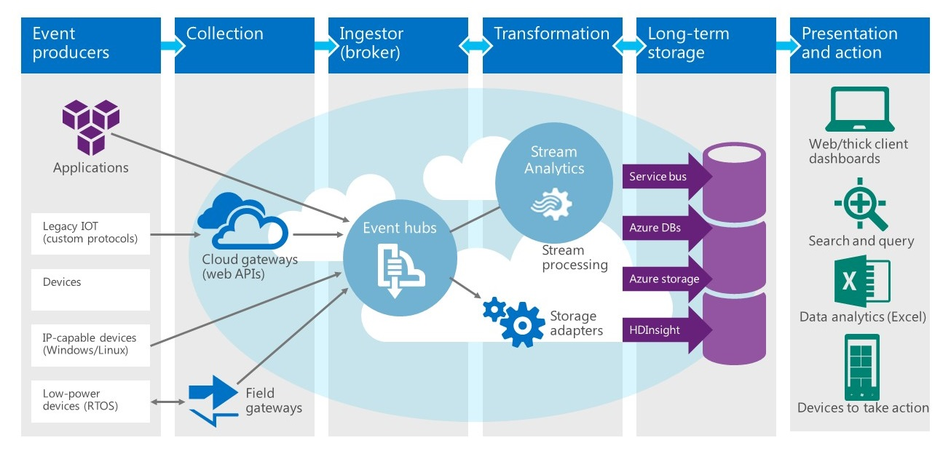
Stream Analytics at Work
Notes:
Here's a typical scenario showing how Stream Analytics is used. On the left are the event producers, such as mobile phones an IoT sensors. They fire events to an Azure event hub (using a cloud gateway as an intermediary if the devices themselves aren't IP-capable), which aggregates the events and delivers them to a Stream Analytics job. Stream Analytics queries the data stream and sends the results to one or more outputs, which might include blob storage, a SQL Azure database, another event hub, or (not shown here) Microsoft Power BI.

Slide 5
Stream Analytics Query Language
SQL-like language for querying live data streams
Subset of T-SQL
Supports bigint, float, nvarchar(max), datetime, record, and array
Supports SELECT, FROM, WHERE, GROUP BY, and other common Data Manipulation Language (DML) statements
Supports COUNT, AVG, DATEDIFF, and other common functions
Adds extensions such as TIMESTAMP BY and System.Timestamp
Supports temporal grouping of events via "windowing"
Notes:
The genius of Azure Stream Analytics is that it allows you to "use what you know" by using SQL to query dynamic data streams. It's not straight SQL, but an enhanced version of T-SQL. The enhancements are necessary to deal with dynamic data. For example, the windowing enhancements enable you to ask questions such as "how many red cars enter the parking lot every 5 minutes?" TIMESTAMP BY lets you designate a field in the data stream as the one that holds the event time -- the time at which the event actually occurred (as opposed to the time the event reached an event hub, which is the default).

Slide 6
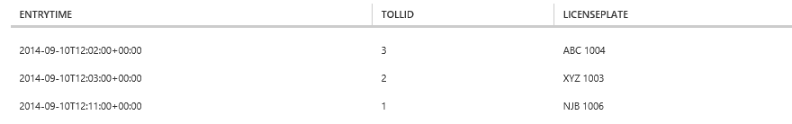
Querying a Data Stream
List all Connecticut cars that enter a toll booth, and include the entry time, toll booth ID, and license-plate number
SELECT EntryTime, TollId, LicensePlate
FROM EntryData
WHERE State = 'CT'
Notes:
This is a simple query that would work against a SQL database. It also works in Azure Stream Analytics. The context is a scenario in which you manage a collection of toll booths, and an event is fired each time a car enters or leaves a tool booth (two separate data streams in this scenario). Each event includes information such as the event time, the make and model of the car, and the car's license plate info (state and license-plate number).

Slide 7
Designating a Field as the Event Time
Designate the EntryTime field as the event time for calculations that involve event time
SELECT System.Timestamp AS [Entry Time],
TollId, LicensePlate
FROM EntryData TIMESTAMP BY EntryTime
WHERE State = 'CT'
Notes:
TIMESTAMP BY is an important extension to the Stream Analytics Query Language because it lets you designate one field in the data stream as the one that specifies the event time -- the time at which the event actually occurred. Without this, queries that involve event times use the time at which the event arrived at the event hub, not the time at which the event occurred. Virtually all IoT data streams include an event-time field.

Slide 8
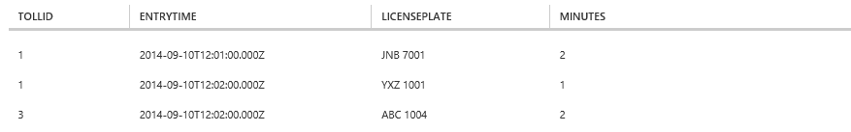
JOINing Two Data Streams
How long does it take each car that enters a tool booth to pay the toll and exit the booth?
SELECT EN.TollId, EN.EntryTime, EN.LicensePlate,
DATEDIFF(minute, EN.EntryTime, EX.ExitTime) AS Minutes
FROM EntryData EN TIMESTAMP BY EntryTime
JOIN ExitData EX TIMESTAMP BY ExitTime
ON EN.TollId = EX.TollId
AND EN.LicensePlate = EX.LicensePlate
AND DATEDIFF(minute, EN, EX) BETWEEN 0 AND 60
Notes:
This query determines how long it took to service each car that entered a toll booth (i.e., the difference between the time the car entered and exited the toll both). It demonstrates the use of the all-important TIMESTAMP BY extension, which allows you to designate a field in the input as the event time. Without TIMESTAMP BY, the event time is the time at which the event arrived at the input source. And it demonstrates that just as you can use JOIN to join two tables in a SQL database, you can use JOIN in Stream Analytics to join two inputs (data streams). In this example, the two data streams are EntryData and ExitData.

Slide 9
Windowing
Count or aggregate events over a specified time period
TumblingWindow
HoppingWindow
SlidingWindow
Notes:
One of the key features of the Stream Analytics Query Language is its ability to group results using windows of time whose length you specify. Syntactically, you exercise windowing by using SQL's GROUP BY clause with TumblingWindow, HoppingWindow, or SlidingWindow. TumblingWindow allows you to ask questions such as "How many red cars go through my toll booths every 5 minutes?" HoppingWindow lets you ask the same question but generate output at intervals that are independent of the window size -- for example, "Tell me once a minute how many red cars go through my toll booths every 5 minutes." SlidingWindow lets you ask "During which 5-minute time periods do 10 or more red cars go through my toll booths?"

Slide 10
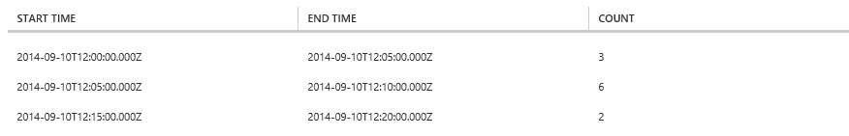
Using TumblingWindow
How many New York cars enter a toll booth every 5 minutes?
SELECT DateAdd(minute, -5, System.TimeStamp)
AS [Start Time], System.TimeStamp AS [End Time],
COUNT(*)
FROM EntryData TIMESTAMP BY EntryTime
WHERE State = 'NY'
GROUP BY TumblingWindow(minute, 5)
Notes:
This query answers the question "How many cars with NY license plates enter my tool booths every 5 minutes?" and generates an output every 5 minutes.

Slide 11
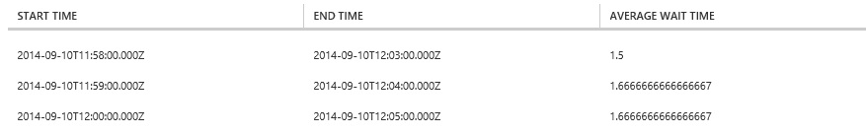
Using HoppingWindow
What is the average wait time at all toll booths for the last 5 minutes, updated every 1 minute?
SELECT DateAdd(minute, -5, System.TimeStamp)
AS [Start Time], System.TimeStamp AS [End Time],
AVG(DATEDIFF(minute, EN.EntryTime, EX.ExitTime))
AS [Average Wait Time]
FROM EntryData EN TIMESTAMP BY EntryTime
JOIN ExitData EX TIMESTAMP BY ExitTime
ON EN.TollId = EX.TollId
AND EN.LicensePlate = EX.LicensePlate
AND DATEDIFF(minute, EN, EX) BETWEEN 0 AND 60
GROUP BY HoppingWindow(minute, 5, 1)
Notes:
This query answers the question "What is the average wait time at all toll booths for the last 5 minutes?" and generates an output every 1 minute.

Slide 12
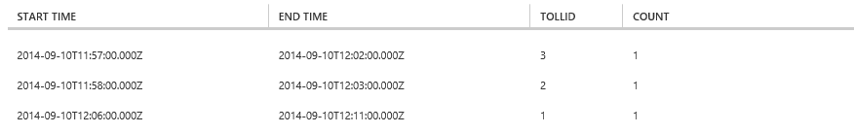
Using SlidingWindow
In which 5-minute windows does at least one Connecticut car enter a toll booth?
SELECT DateAdd(minute, -5, System.TimeStamp)
AS [Start Time], System.TimeStamp AS [End Time],
TollId, COUNT(*)
FROM EntryData TIMESTAMP BY EntryTime
WHERE State = 'CT'
GROUP BY TollId, SlidingWindow(minute, 5)
HAVING COUNT(*) > 0
Notes:
This query answers the question "Which toll booths have served at least one car with CT plates in any 5-minute period?"

Slide 13
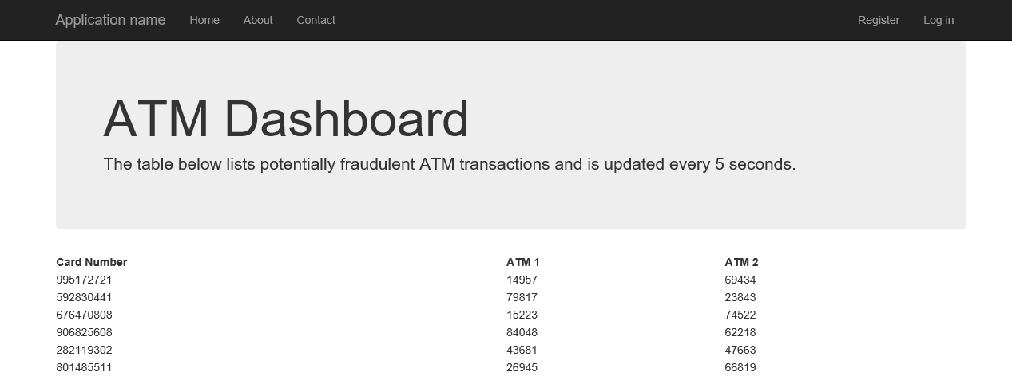
Building Real-Time Dashboards
Direct Stream Analytics output to an Azure event hub
Write code that subscribes to events from the event hub
Notes:
You can connect Microsoft Power BI to a Stream Analytics output and generate graphical dashboards without writing any code. Or, if you're a developer, you can use an event hub as output from a Stream Analytics job and build highly customized dashboards by writing code that subscribes to events fired from the event hub. That is exactly what you'll do in the next lab. The screen shot in this slide shows a preview of what you're going to build.

Slide 14
Hands-On Lab
Azure Stream Analytics HOL.html

